Slide 1
Behaviors

Slide 2
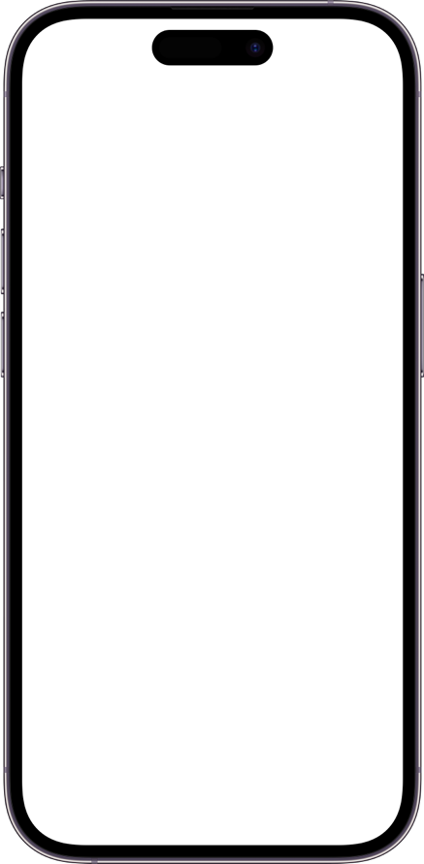
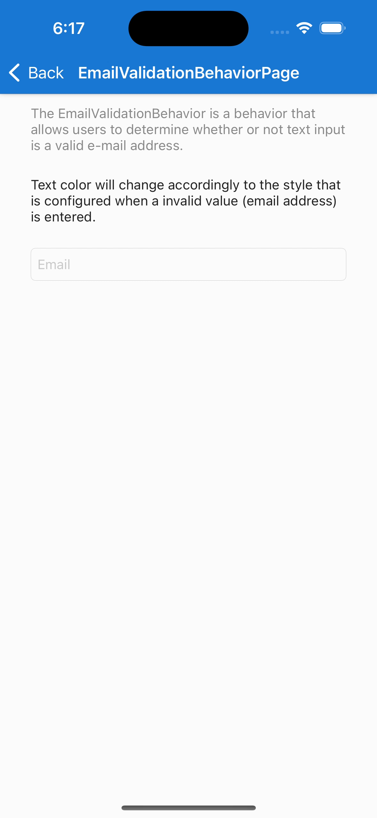
Creating UI Behaviors
Bolt-on Functionality
Can be added to any VisualElement
(Example) Email Validation Behavior added to Label
Sample from .NET MAUI Community Toolkit

Slide 3
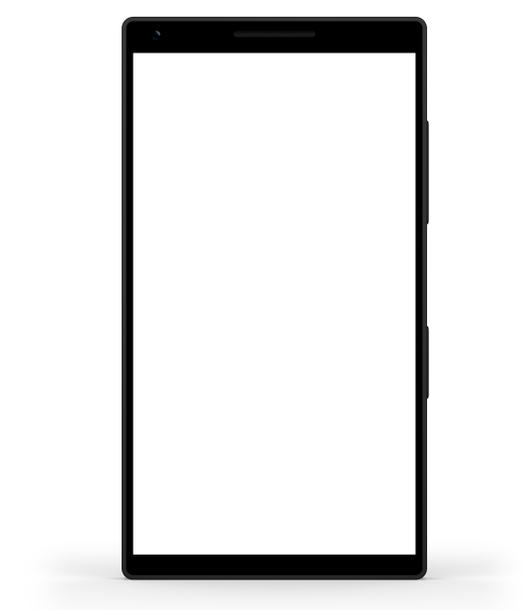
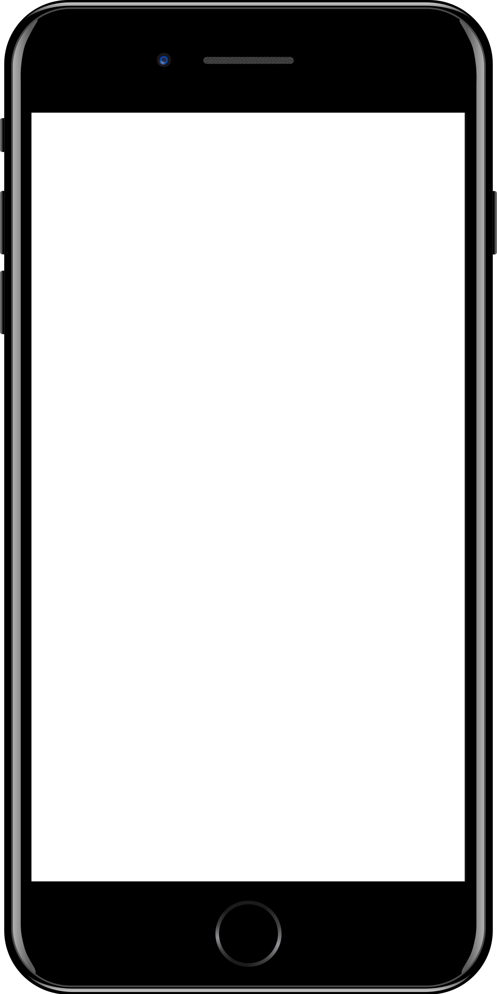
Sample mobile app slide
iPhone 7/8
iPhone 14
Generic phone
(BrandCentral)
App screenshots can be placed behind these transparent .pngs

Slide 4
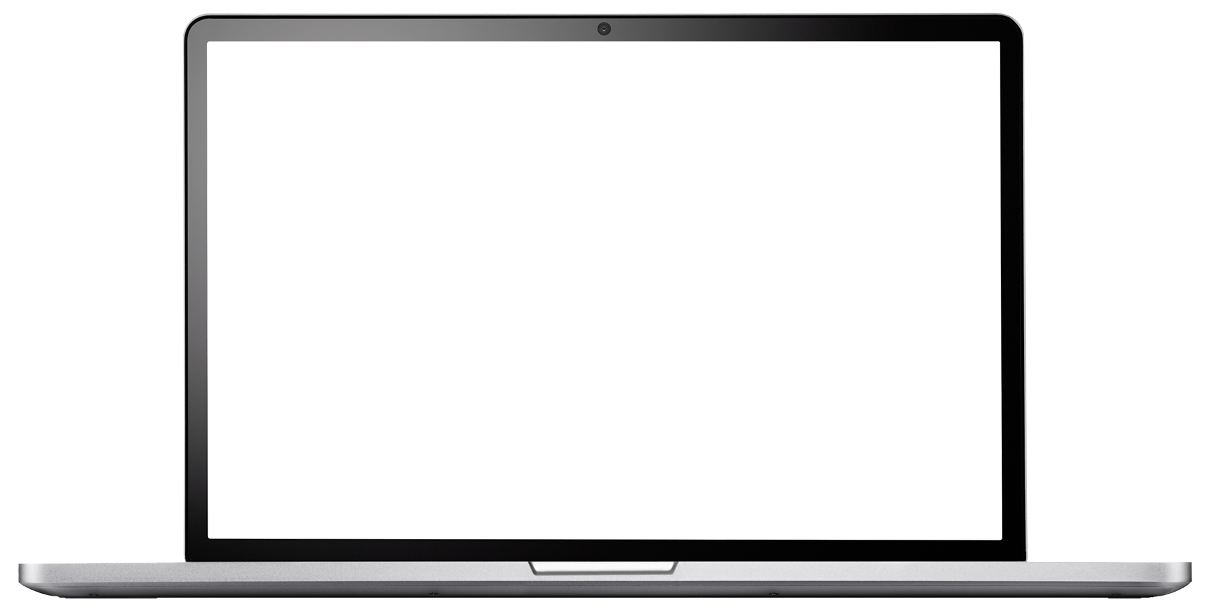
Sample website slide (blank)
Website screenshots can be placed behind this transparent .png

Slide 5
Bullet points layout with subtitle Subtitle is smaller in the same text block
Example of a bulleted slide with a subhead
Set the slide title to “Sentence case”
Set subheads to “Sentence case”
Hyperlink style
www.microsoft.com

